Slide 1
How Trump Has Mattered for Trade Policies
Alan V. Deardorff
For presentation at Adult Learning Institute
Oakland Community College
September 19, 2017

Slide 2

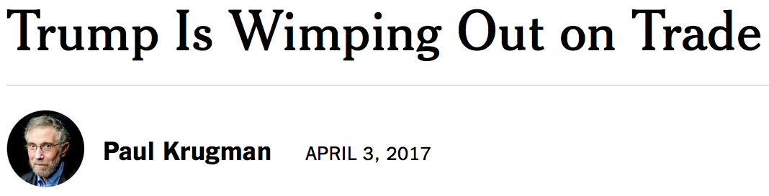

Slide 3
Trump’s Trade Policies as of September 19, 2017
Trade staff
TPP
NAFTA
Other FTAs
Factory location
Border tax adjustment
Exchange rates
WTO
Executive orders
National-security tariffs
Other

Slide 4
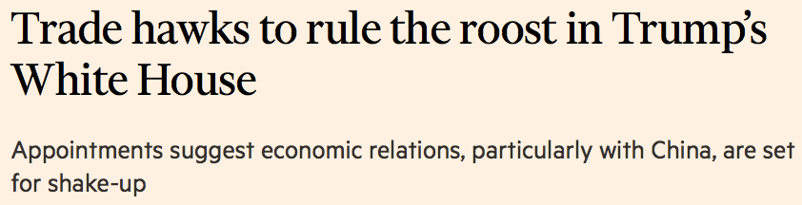
Trade Staff
Dec 22, 2016:

Slide 5
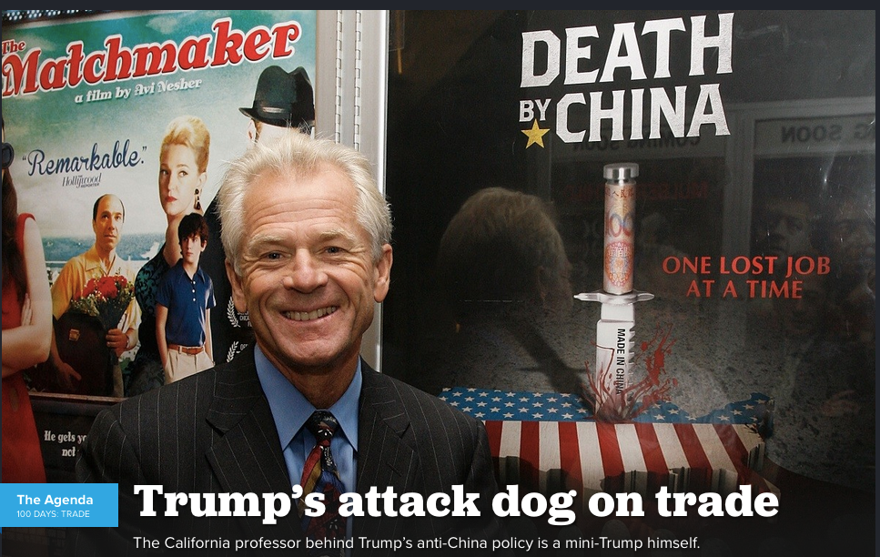
Trade Staff
Peter Navarro: Director of the National Trade Council at the White House

Slide 6
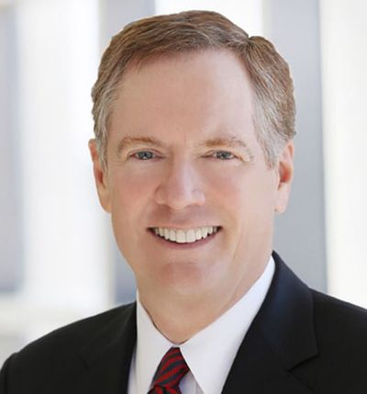

Trade Staff
Robert Lighthizer: United States Trade Representative

Slide 7
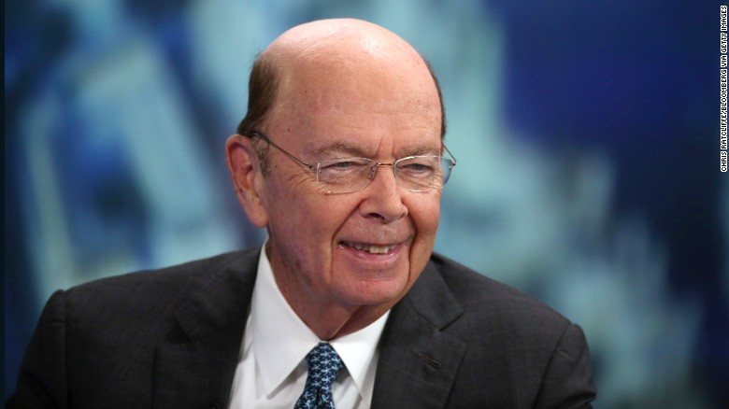
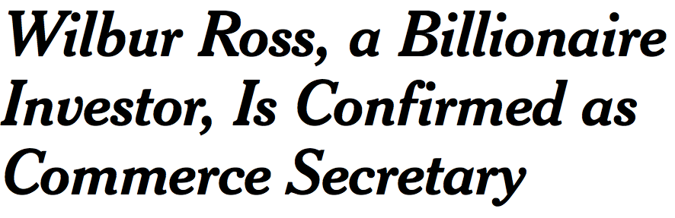
Trade Staff
Secretary of Commerce: Wilbur Ross

Slide 8
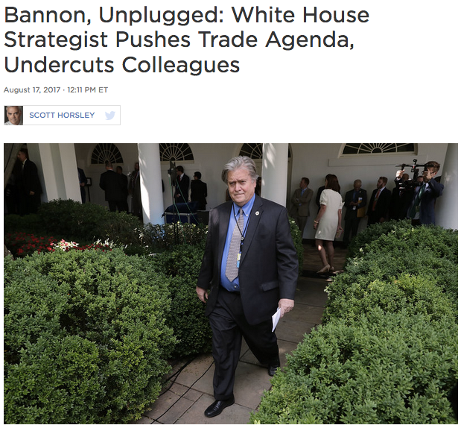

X
Notes:
http://www.npr.org/2017/08/17/544162664/bannon-unplugged-white-house-strategist-pushes-trade-agenda-undercuts-colleagues

Slide 9
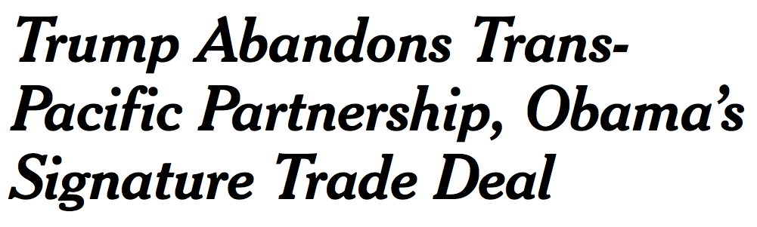


Trans-Pacific Partnership
TPP = Free Trade Agreement negotiated under Obama among 12 countries (not China)

Slide 10
North American Free Trade Agreement
NAFTA = Free Trade Agreement since 1994 with Canada and Mexico
  Nov 21, 2016:
  Feb 1, 2017:
  Mar 30, 2017:

Slide 11

North American Free Trade Agreement
NAFTA Renegotiation
  Aug 17, 2017:
  Aug 23, 2017
  Sep 6, 2017

Slide 12
North American Free Trade Agreement
What the Trump administration wants in NAFTA
  “Improve US trade balance,” overall & within NAFTA
  “Maintain existing reciprocal duty-free market access”
    “while taking into account U.S. import sensitivities”
  “Update and strengthen the rules of origin”
  Permit “Buy American” in government procurement
  Several features that were part of TPP (labor, environment, digital)
  “Eliminate Chapter 19” (which weakens US anti-dumping)
  Unclear about Chapter 11, investor-state dispute settlement
  “Ensure that the NAFTA countries avoid manipulating exchange rates”

Slide 13

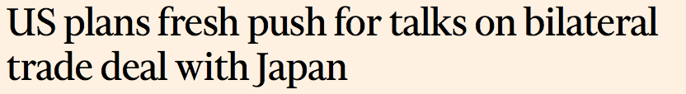
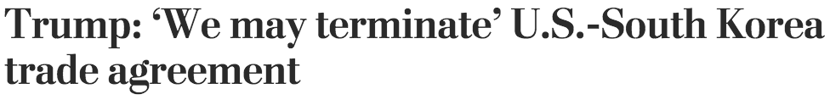

Other Free Trade Agreements
Jan 27, 2017
Feb 2, 2017
Apr 27, 2017:

Slide 14
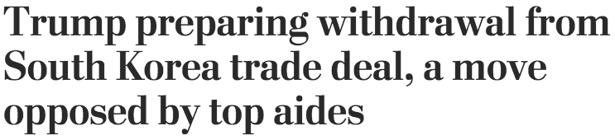

KORUS:
Korea-US Free Trade Agreement
Sep 2, 2017
Sep 5, 2017
Now discussing “amendments"

Slide 15
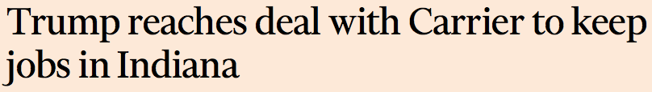
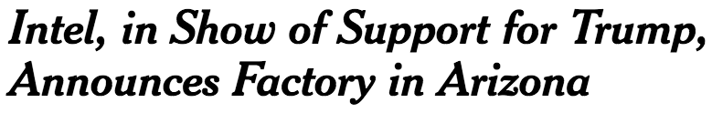

Trump influence on factory locations
Nov 30, 2016
Dec12, 2016:
Dec 5, 2016:
Feb 8, 2017:
Mar 29, 2017

Slide 16
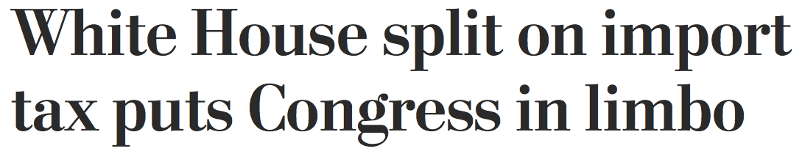
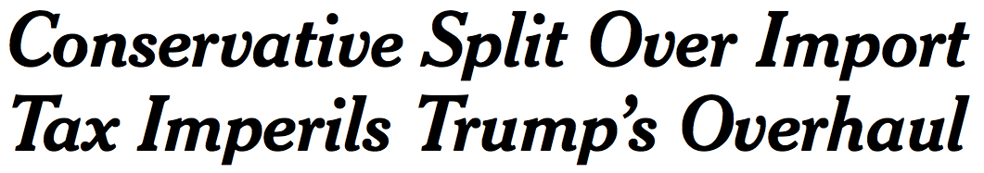

Border Tax Adjustment
= Tax on imports and subsidy on exports, similar to border adjustment of Value Added Tax (VAT)
Jan 27, 2017:
Mar 3, 2017:
Apr 1, 2017:
Jul 27, 2017

Slide 17
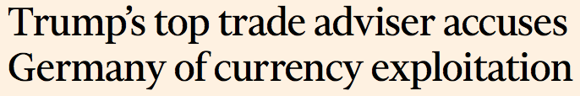
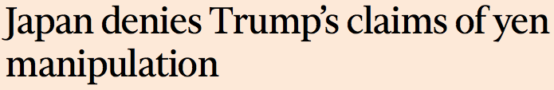
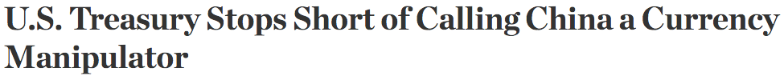
Exchange Rates
Jan 24, 2017 (Trump does not name China as currency manipulator)
Jan 31, 2017:
Feb 1, 2017:
Apr 15, 2017:

Slide 18
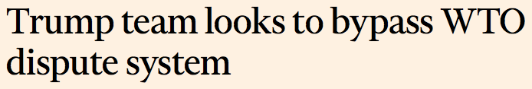

World Trade Organization
Feb 27 2017:
Mar 1, 2017:

Slide 19
Trump’s Executive Orders
March 31, 2017
“Enhanced AD/CVD Collection & Enforcement Executive Order”
  Will use “bonding requirements, based on risk assessments, on entries of articles subject to” AD and CVD duties. There is a 90-day period for developing a plan to do this.
  Another 90-day period for developing a strategy for stopping imports that violate other laws, including IP.
  Instructs the Attorney General (in consultation with the Secretary of Homeland Security) to develop practices for prosecuting those who violate US trade laws
No news yet

Slide 20
Trump’s Executive Orders
March 31, 2017
“Omnibus Report On Significant Trade Deficits”
  Preface: “[F]or many years, the United States has not obtained the full scope of benefits anticipated under a number of international trade agreements or from participating in the World Trade Organization.” Evidence of this is the annual trade deficit, which exceeded $700 billion in 2016.
  It requires an Omnibus Report within 90 days, by June 29, 2017
No news yet

Slide 21
Trump’s Executive Orders
March 31, 2017
“Omnibus Report On Significant Trade Deficits”
  The Report shall
    Identify those trading partners with which the US had significant trade deficits in 2016.
    Assess the causes of these deficits in the policies and actions of the countries and their governments.
    Assess the implications of the deficits for the strength of US manufacturing, employment, wage growth, and national security.
  The Report is to draw from comments by stakeholders, “including manufacturers, workers, consumers, service providers, farmers, and ranchers.” [Note: Not economists.]

Slide 22
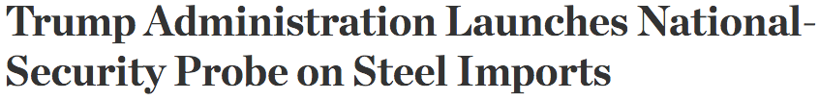



National Security Tariffs
Apr 21, 2017
Jul 19, 2017
Jul 25, 2017

Slide 23
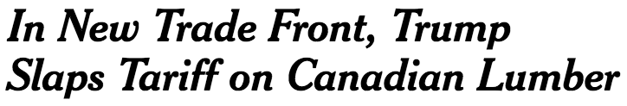
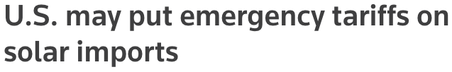
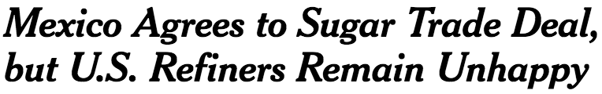
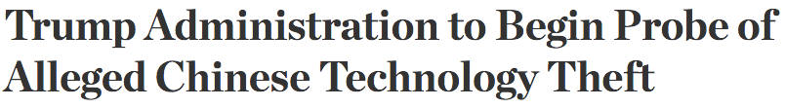
Other Trade Disputes
Apr 24, 2017
May 29, 2017
Jun 6, 2017
Aug 14, 2017

Slide 24
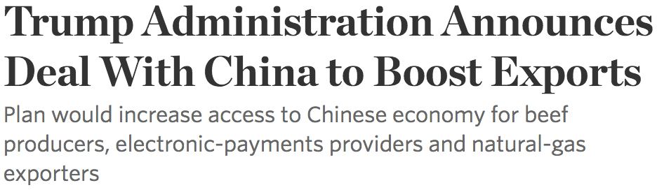

Other Trade Deals
May 12, 2017
Jul 8, 2017

Slide 25
Trump’s Trade Policies
Issue | Outcome so far
Staff | Still in place, but Bannon gone
TPP | Pulled out, but much is to be in NAFTA
NAFTA | Threated pull-out, but now renegotiating
Other FTAs | Threated pull-out of KORUS, but backed off
Factory location | Did little once in office
Border tax adjustment | No longer planned
Exchange rates | Didn’t name China; including in NAFTA
WTO | Still participating, reluctantly
Executive orders | Surprisingly mild
National-security tariffs | Now not likely
Other | Using some laws like predecessors; but not others

Slide 26


Conclusion
Has Trump “wimped out” on trade?
  Not on TPP (but it was doubtful anyway)
  Yes on NAFTA, probably
  Other things: Some yes, but we’ll see

Slide 31
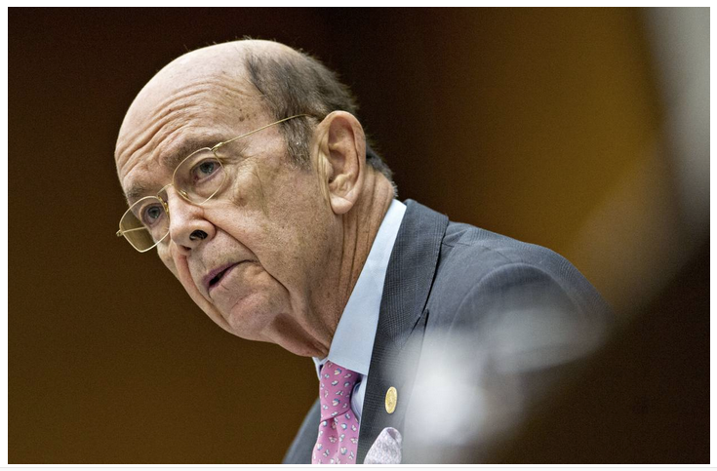
May 12, 2017
Notes:
https://www.wsj.com/articles/trump-administration-announces-deal-with-china-to-boost-exports-1494558000?tesla=y

Slide 32
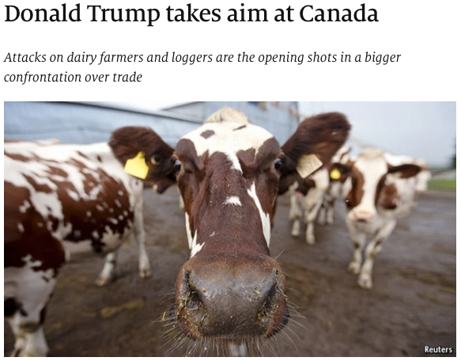
Notes:
https://www.economist.com/news/americas/21721416-attacks-dairy-farmers-and-loggers-are-opening-shots-bigger-confrontation-over

Slide 33
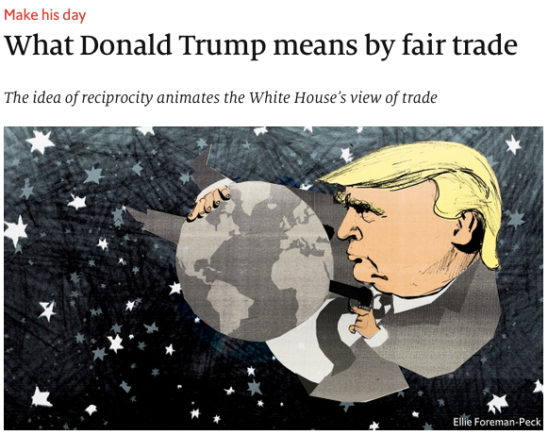
Notes:
https://www.economist.com/news/briefing/21721935-idea-reciprocity-animates-white-houses-view-trade-what-donald-trump-means-fair

Slide 34
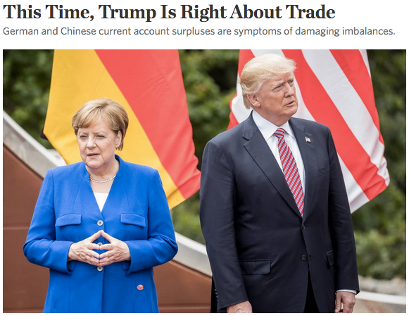
Notes:
https://www.wsj.com/articles/this-time-trump-is-right-about-trade-1496223180?tesla=y

Slide 35
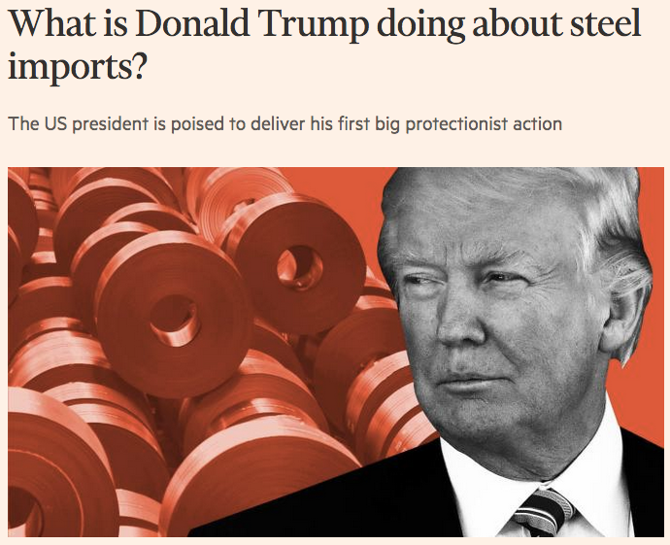
Notes:
https://www.ft.com/content/8c1e9f0e-56c2-11e7-9fed-c19e2700005f

Slide 36
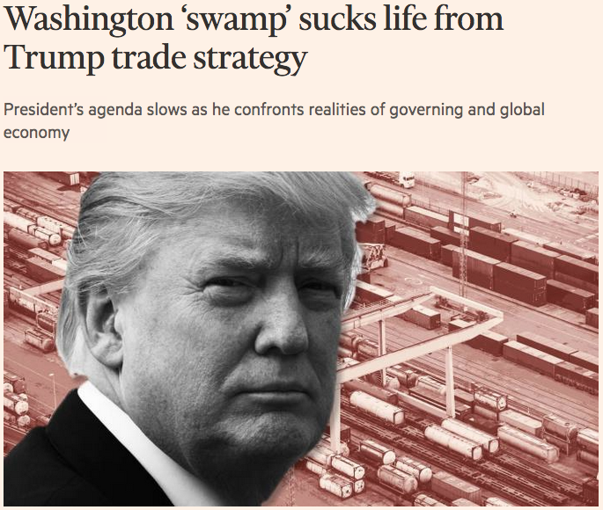
Notes:
https://www.ft.com/content/021d71a8-772f-11e7-90c0-90a9d1bc9691

Slide 37
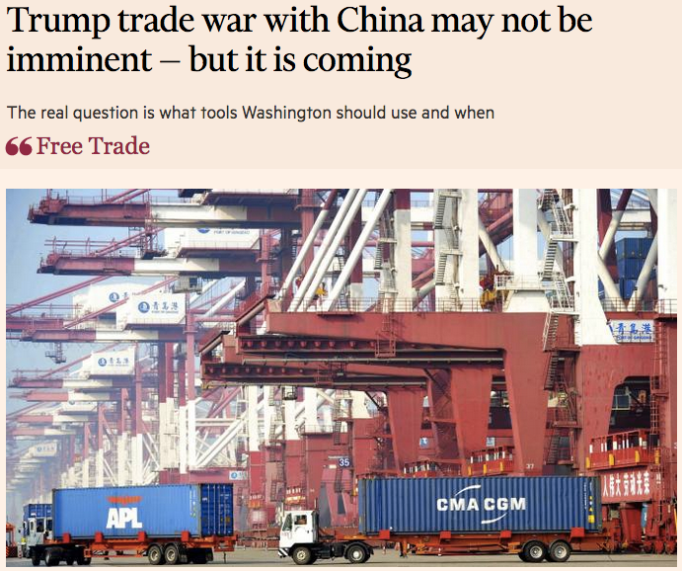
Notes:
https://www.ft.com/content/3e14037e-7b4f-11e7-9108-edda0bcbc928

Slide 38
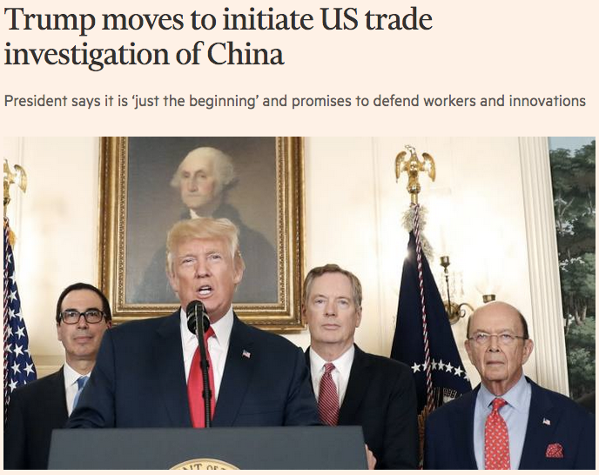
Notes:
https://www.ft.com/content/6805bd20-8131-11e7-a4ce-15b2513cb3ff

Slide 39
Notes:
http://www.npr.org/2017/08/17/544162664/bannon-unplugged-white-house-strategist-pushes-trade-agenda-undercuts-colleagues

Slide 40
😀
😒

